Slide 1
What is classification and segmentation?

Slide 2
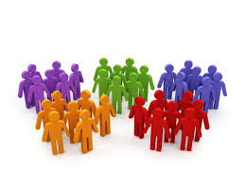
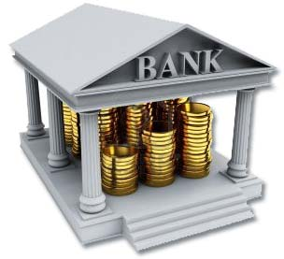
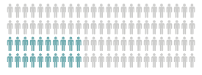

Bank
Customer Segments
Loyal/Disloyal
Risky/Defaulter

Slide 3

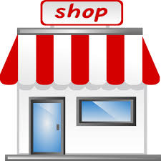

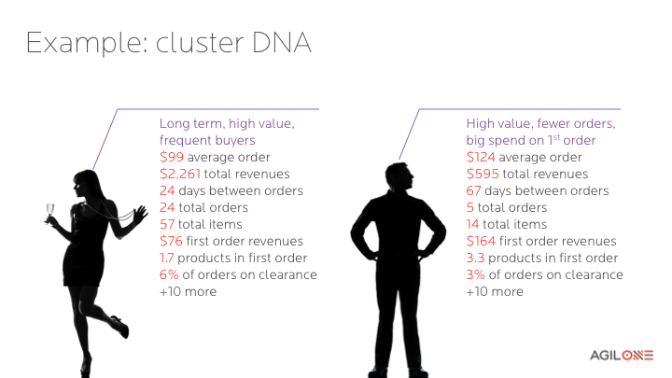
Retailer

Slide 4
Classification techniques help predict group membership and also describe characteristics that discriminate
Group memberships/classes
Characteristics useful in classifying
loyal customers versus customers who will churn;
High price sensitive versus low price sensitive customers;
Satisfied versus dissatisfied customers;
Purchasers versus non-purchasers;
Assets that increase in value versus not
Products that may be good recommendations to a customer versus not, etc.
(1) Demographics;
(2) Psychographics;
(3) Past behaviour;
(4) Attitudes towards specific products,
(5) Social network data, etc

Slide 5
Supervised vs. Unsupervised techniques
Supervised Algorithms
These algorithms make predictions on given set of samples, by searching for patterns within the value labels assigned to data points.
Unsupervised Algorithms
There are no labels associated with data points. These algorithms organize the data into a group of clusters to describe its structure and make complex data look simple and organized for analysis.

Slide 6
Classification techniques – Supervised/Unsupervised
There are many techniques for solving classification problems:
Logistic regression
K Means clustering
Classification/Decision trees
Discriminant analysis
Neural networks
Boosted trees
Random forests
Deep learning methods
Nearest neighbours
Support vector machines
Naïve Bayes

Slide 7
What is Clustering?

Slide 8
Agenda
What is Clustering
Clustering Methodologies
K-Means Clustering
Business Cases

Slide 9
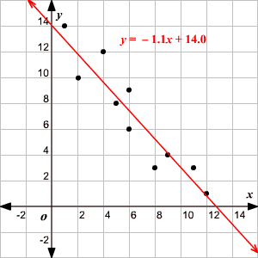
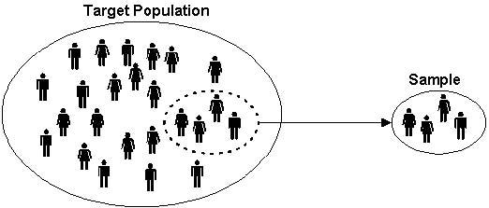
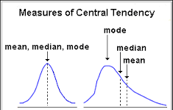
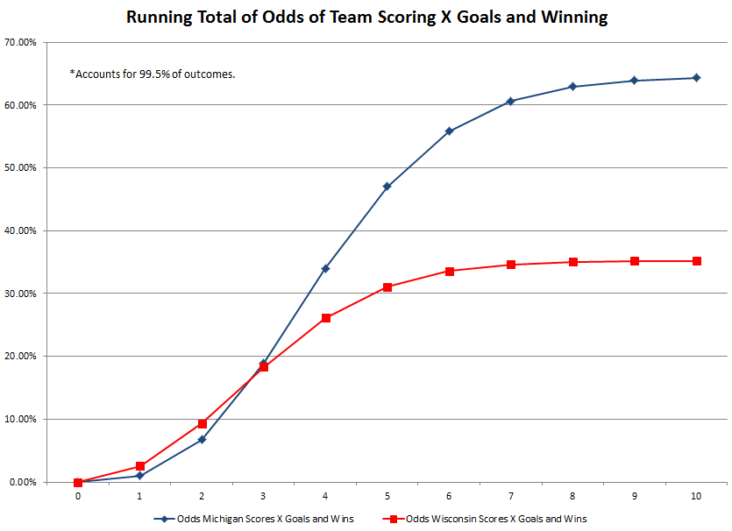
Re-cap: Statistical concepts
Statistics
In the broadest sense, "statistics" refers to a range of techniques and procedures for analyzing, interpreting, displaying, and making decisions based on data
Concepts
Descriptive vs Inferential statistics
Sample vs. Population
Independent vs. Dependent Variables
Qualitative vs. Quantitative data
Statistical measures
Measures of Central tendency
Measures of dispersion
Underlying distribution
Common statistical problems
Classifying products by attributes
Identifying impact of pricing on sales
Predicting next most popular product
Evaluating campaigns and optimizing spends

Slide 10
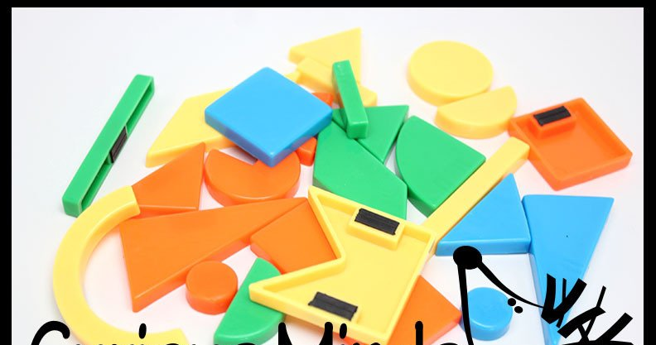
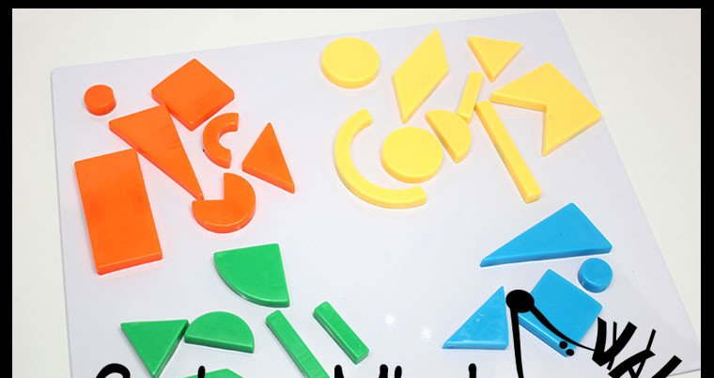
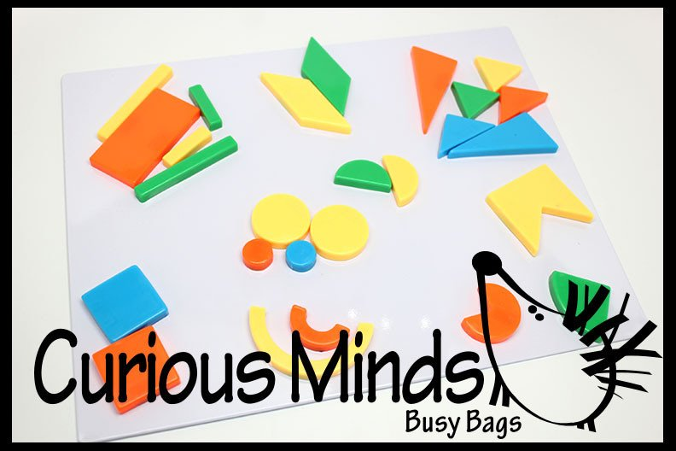
Re-cap: Classification
Classification (Supervised)
– Is used to classify entities into pre-defined groups
– Requires groups/features/classes to be pre-defined
– Is a supervised learning technique
Clustering (Unsupervised)
– Is used to create groups using common features of the entities
– No pre-defined groups/features/classes
– Is an unsupervised learning technique
Can you group these items into logical groups?
Color
Can you group these items by color?
Shape
Notes:
Clustering: In clustering you group(cluster) the data based on some variables into some number of groups (cluster). Classification: In classification, you have certain groups & you want to know how different variables are related to the groups.

Slide 11
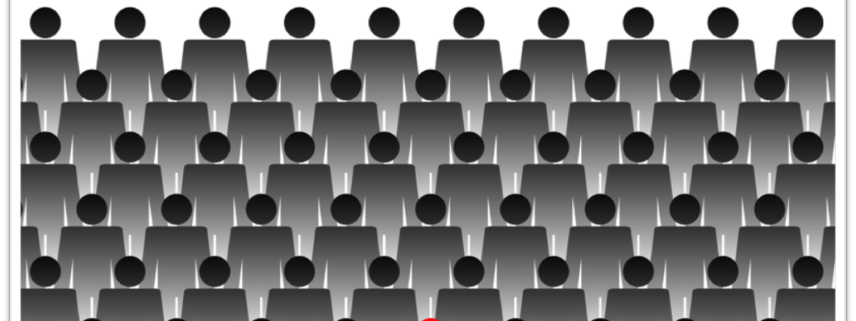

Introduction: Clustering
Clustering
Is the task of grouping a set of objects in such a way that
objects in the same group (called a cluster) are as similar as possible (in some sense or another) within the same group
objects in one group (called a cluster) are as far apart as possible among different groups
Clustering partitions the set of data into groups based on data similarity and then assigns the labels to the groups
Helps in partitioning massive data into un-biased groups based purely on observed features
Helps subsequent data mining processes, such a pattern discovery, classification and outlier analysis.
The main advantage of clustering over classification is that, it is adaptable to changes and helps single out useful features that distinguish different groups
Gender?
Age + Gender?
Age?

Slide 12
Clustering: Need and value
Clustering has multiple uses -
Data management: clustering helps in data summarization, compression, and reduction
Marketing: finding like-minded users from a large database of customer data using their properties and past buying records to enable recommendation systems
Biology: better classification of plants and animals given their features
Libraries: book ordering and recommendations
Insurance: detecting frauds, anomalies in groups of policy holders with a high average claim cost
City-planning: generating housing localities and policies based on house type, value, geographical location, etc.
Earthquake studies: clustering observed earthquake epicenters to identify dangerous zones

Slide 13
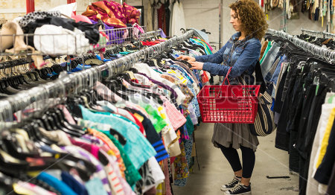


Clustering: Business case
A clothing retailer wishes to run targeted campaigns on its 1.3MM loyalty card customers based on their buying patterns (transaction value, frequency, shopping basket, etc.)
Challenges
Large amount of data
How to group customers
Solution: Clustering
Can identify hidden patterns and structures in the data without formulating
a specific hypothesis
Does not need a target variable (Retailer does not know what the customer
groups could be)
Outcome
Clear pattern of purchase behavior identified
Brand conscious buyers and deal buyers
Business Implication
Brand product line extensions, cross-category product mailers directed to
“Value for brand” customers
Deals, discounts, savers mailers directed to “Value for money” customers
Watch-outs
Clustering groups customers into similar groups, however, the domain expert (in this case the retailer) needs to identify what the group is based on its composition

Slide 14
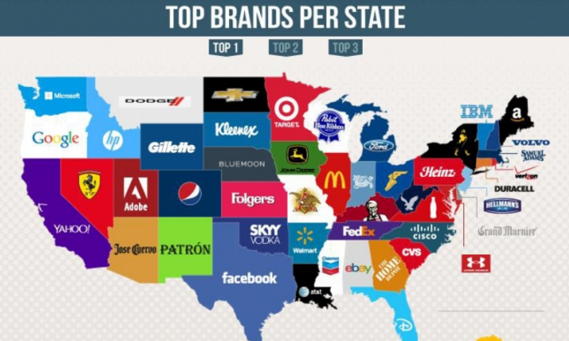
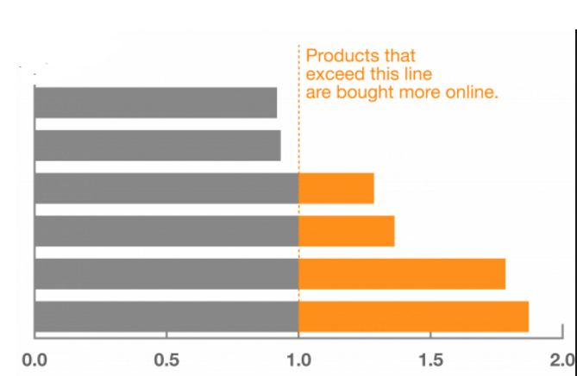

Clustering using product attributes
Product attributes (price, specs, category, etc.) can form basis for product clustering that enables business and productivity optimization
Supply-chain optimization
Product clusters reveal preferential purchase patterns by geography (zipcode, locality)
Optimize supply-chain to maximize demand fulfillment
Channel optimization
Product clusters reveal preferential purchase patterns by channel (online, offline, mult-channel)
Optimize channel assortment to better utilize shelf-space
Competition optimization
Product clusters reveal assortment patterns and overlaps by competition (Ebay vs. Amazon/Walmart.com)
Optimize product assortment to be at competitive advantage
Books
Video games
Videos
Event tickets
Computer software
Music

Slide 15
Question
Which of the following tasks do you think are fit for clustering? Select all that apply
Dividing search results on Google into categories based on the topic
Grouping players into different “types” of basketball players that make it to NBA
Predicting winner of T20 series in 2017

Slide 16
Clustering Methodologies

Slide 17
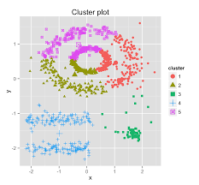
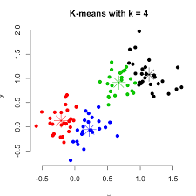
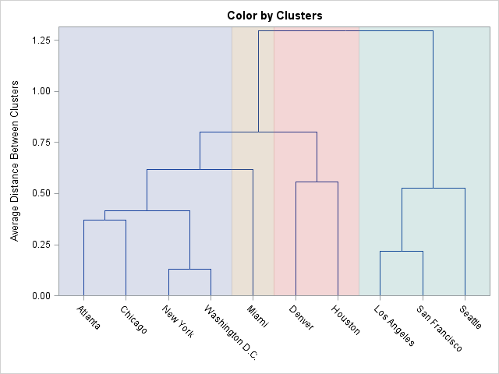
Clustering methodologies
Distance-based methodologies
Flat/Partitioning method – Partitions the data in a high dimension space, into multiple clusters. Partitions are independent of each other. The typical methods include K-Means, K-Medoids, K-Medians, Gaussian mixture models, etc.
Hierarchical method – is based on the core idea of objects being more related to nearby objects than to objects farther away. This does not provide a single partitioning of the dataset, but instead provides an extensive hierarchy of clusters that merge with each other at certain distances. Partitions can be visualized using a tree structure (a dendrogram) - agglomerative clustering, divisive clustering
Density-based methodologies – Here the clusters are defined as areas of higher density. The basic idea is to continue growing a cluster as long as the density in the neighborhood exceeds some threshold, i.e., for each data point within a given cluster, the radius of a given cluster has to contain at least a minimum number of points.
Probabilistic models - The clustering model most closely related to statistics is based on distribution models. Clusters can then easily be defined as objects belonging most likely to the same distribution. A convenient property of this approach is that this closely resembles the way artificial data sets are generated: by sampling random objects from a distribution.

Slide 18
K-Means Clustering
Partitioning algorithm

Slide 19
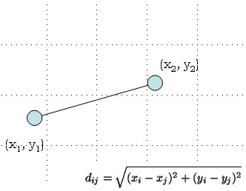
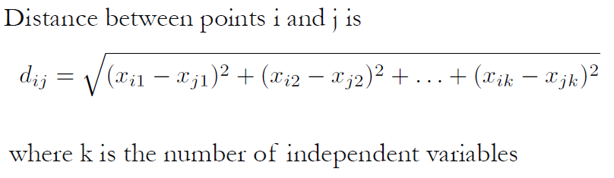
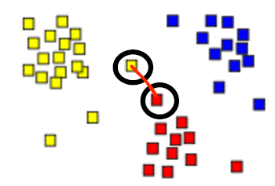
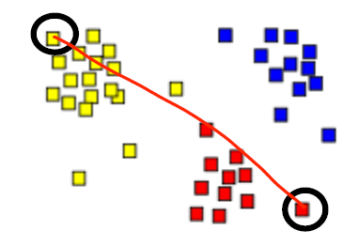
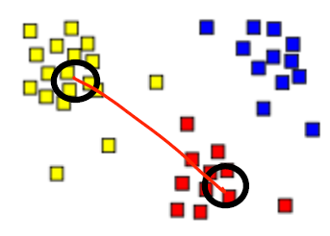
Pre-requisites to K-means clustering
Normalization : In order to give equal weightage to the variables, it is important to normalize the data
Euclidean distance: To define distance between two data points
Minimum distance
Distance between closest two data points
Maximum distance
Distance between farthest two data points
Centroid distance
Distance between centroids of clusters, where centroid is the average of data points in each cluster

Slide 20
Question
Movie genres (thriller, comedy, regional, etc.) are defined by vector (Eg: If movie is thriller, it is defined by vector [1,0,0,…])
“The Godfather” is in the genre of action, crime and drama, defined by vector [0,1,0,0,0,0,1,0,1,0,0,0,0,0,0,0,0,0,0]
“Titanic” is in the genre of action, drama and romance, defined by vector [0,1,0,0,0,0,0,0,1,0,0,0,0,0,1,0,0,0,0]
What is the distance between “The Godfather” and “Titanic”, using Euclidean distance?
Notes:
1.4142

Slide 21
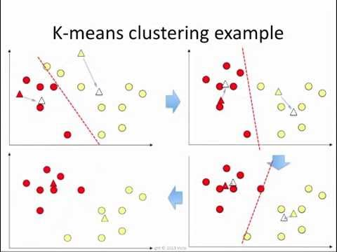
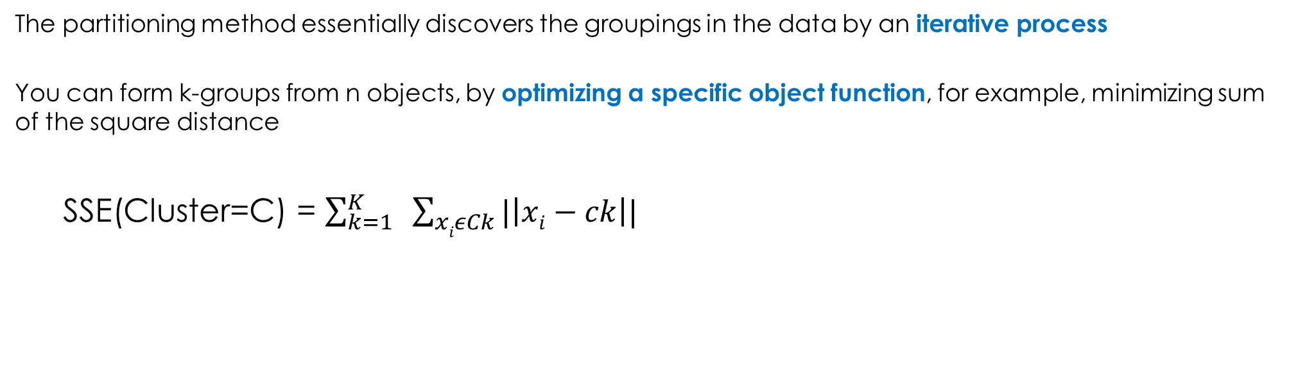
Partitioning method
The partitioning method essentially discovers the groupings in the data by an iterative process
You can form k-groups from n objects, by optimizing a specific object function, for example, minimizing sum of the square distance
SSE(Cluster=C) = $\sum_{k=1}^{K}{ \sum_{xiεCk}{|\left|xi−ck\right||}}$
Which partition gives the minimum SSE?
To find a global optimal, actually we need to exhaustively enumerate all partitioning because the potential number of partitioning actually is exponential.
Hence the need for a heuristic method or a greedy algorithms

Slide 22
Clustering problem: Let’s solve
Group students based on their scores on two subjects.
Step 1: Find a sensible initial partition
Taking the two individuals farthest apart (using the Euclidean distance measure)
Step 2: Classify the remaining students
Allocate remaining students to the cluster to which they are closest
Recalculate the cluster centroid each time a new member is added
Identify the centroid for the new clusters
Step 3: Validate the classification
Compare each individual’s distance to its own cluster
mean and to that of the opposite cluster
Check for any anomalies/mis-classifications
Relocate any anomalies to the rightful cluster iteratively
until all anomalies are addressed and distance is minimized
4. Step 4: Finalize the cluster and nomenclature
Student | Math | English
A | 1.0 | 1.0
B | 1.5 | 2.0
C | 3.0 | 4.0
D | 5.0 | 7.0
E | 3.5 | 5.0
F | 4.5 | 5.0
G | 3.5 | 4.5
 | Cluster 1 |  | Cluster 2
Step | Student | Centroid | Student | Centroid
1 | A | 1.0, 1.0 | D | 5.0, 7.0
2 | A, B | 1.2, 1.5 | D | 5.0, 7.0
3 | A, B, C | 1.8, 2.3 | D | 5.0, 7.0
4 | A, B, C | 1.8, 2.3 | D, E | 4.2, 6.0
5 | A, B, C | 1.8, 2.3 | D, E, F | 4.3, 5.7
6 | A, B, C | 1.8, 2.3 | D, E, F, G | 4.1, 5.4
Student | Distance from centroid (cluster1) | Distance from centroid (cluster2) | Cluster
A | 1.5 | 5.4 | 1
B | 0.4 | 4.3 | 1
C | 2.1 | 1.8 | 1
D | 5.7 | 1.8 | 2
E | 3.2 | 0.7 | 2
F | 3.8 | 0.6 | 2
G | 2.8 | 1.1 | 2
Cluster | Students | Centroid
Beginners | A, B | 1.3, 1.5
Intermediates | C, D, E, F, G | 3.9, 5.1

Slide 23
Question
Is it possible that the SSE increases after we recompute new centers in the k-means algorithm? Why?
Yes, it is possible. Because the new centers may be worse than before
No, it is not possible. The new center of a cluster comes from the average of all data points in this cluster, which actually minimizes the SSE
Explanation - The SSE approaches the “minimum SSE” when subsequent iterations are run. That is how the k-means algorithm will finally converge

Slide 24
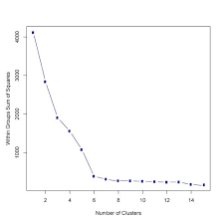
Determining K, Initialization & Validation
Determining K (number of clusters)
Often a range of values are run to select the best K
Use elbow chart – plot of k and SSE(C_{k})
Initialization
K-Means clustering may terminate at a local optimal. Hence Initialization can be important to find high quality clusters.
Multiple runs using different seeds (start points)
Validation
Measuring clustering quality is an important issue because clustering is an unsupervised technique
Compare the clustering results with prior knowledge
Evaluate how well the clusters are separated and how compact the clusters are

Slide 25
Key points on K-Means clustering
K-means clustering is an efficient method as number of iterations and number of clusters are usually far smaller than number of observations.
K-means can work smoothly on large datasets, which is an advantage over Hierarchical clustering
However, K-means works on continuous data. K-modes can be used for categorical data
In k-means one needs to select the number of clusters a-priori
Hierarchical clustering gives more flexibility in this area
K-means not good to find clusters with non-circular shapes
Density based clusters can handle such data better

Slide 26
Question
If you wanted to find more unusual patterns shared by a small number of people, would you increase or decrease the number of clusters?
Increase
Decrease

Slide 27
Thank you

